Slide 1
OPERATING SYSTEMS
IO SYSTEMS
Jerry Breecher

Slide 2
IO SYSTEMS
This material covers Silberschatz Chapters 12 and 13.
Mass Storage - hardware
This is about Disk Behavior and Management.
Disk Characteristics
Space Management
RAID
Disk Attachment
IO Interface – how the OS interfaces to the hardware
The busses in the computer and how the O.S. interfaces to it.
Talking to the IO – Polling, Interrupts and DMA
Application IO Interface
Kernel IO Subsystem

Slide 3
Disk
Characteristics
Mass-Storage Structure
A disk can be viewed as an array of blocks. In fact, a file system will want to view it at that logical level.
However, there's a mapping scheme from logical block address B, to physical address (represented by a track / sector pair.)
The smallest storage allocation is a block - nothing smaller can be placed on the disk. This results in unused space (internal fragmentation) on the disk, since quite often the data being placed on the disk doesn't need a whole block.

Slide 4

Disk Scheduling
Mass-Storage Structure
The components making up disk service time include:
  time = setup + seek + rotation time + transfer + wrap-up
The methods discussed below try to optimize seek time but make no attempt to account for the total time. The ideal method would optimize the total time and many controllers are now able to accomplish this.

Slide 5
Disk Management
Mass-Storage Structure
Disk formatting Creates a logical disk from the raw disk. Includes setting aside chunks of the disk for booting, bad blocks, etc. Also provides information needed by the driver to understand its positioning.
Boot block That location on the disk that is accessed when trying to boot the operating system. It's a well-known location that contains the code that understands how to get at the operating system - generally this code has a rudimentary knowledge of the file system.
Bad blocks The driver knows how to compensate for a bad block on the disk. It does this by putting a pointer, at the location of the bad block, indicating where a good copy of the data can be found.
Swap Space Management The Operating System requires a contiguous space where it knows that disk blocks have been reserved for paging. This space is needed because a program can't be given unshared memory unless there's a backing store location for that memory.

Slide 6
Disk Attachment
Mass-Storage Structure
Host-attached storage
accessed through I/O ports talking to I/O busses
SCSI itself is a bus, up to 16 devices on one cable, SCSI initiator requests operation and SCSI targets perform tasks
  Each target can have up to 8 logical units (disks attached to device controller
Fibre Channel (FC) is high-speed serial architecture
  Can be switched fabric with 24-bit address space – the basis of storage area networks (SANs) in which many hosts attach to many storage units
Serial ATA (SATA) – current standard for home & medium sized servers.
  Advantage is low cost with “reasonable” performance.

Slide 7
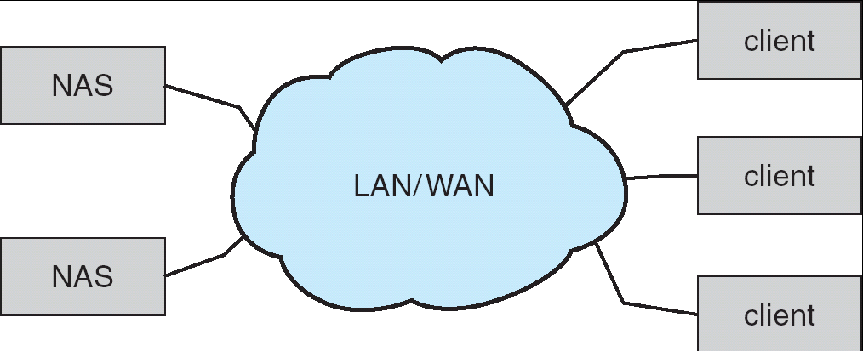
Disk Attachment
Mass-Storage Structure
Network-attached storage
Network-attached storage (NAS) is storage made available over a network rather than over a local connection (such as a bus)
NFS and CIFS are common protocols
Implemented via remote procedure calls (RPCs) between host and storage
New iSCSI protocol uses IP network to carry the SCSI protocol

Slide 8
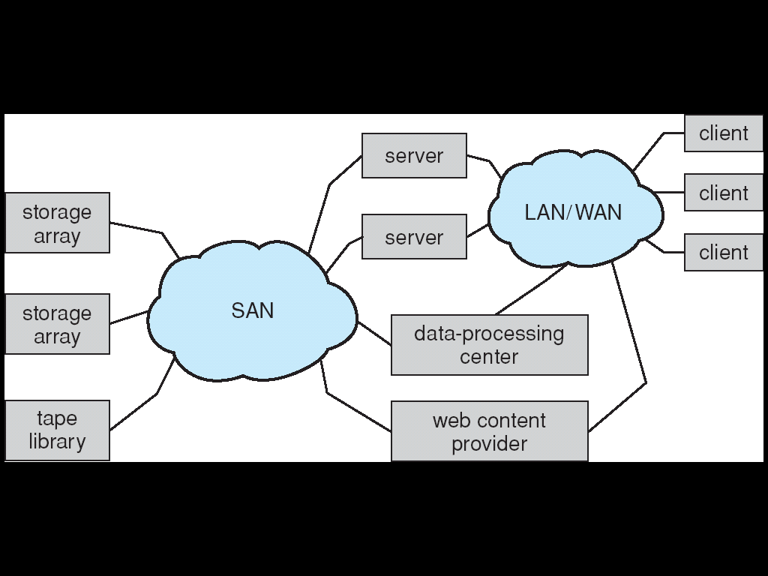
Disk Attachment
Mass-Storage Structure
Storage-Area Network
Common in large storage environments (and becoming more common)
Multiple hosts attached to multiple storage arrays - flexible

Slide 9
Reliability
Mass-Storage Structure
MIRRORING One way to increase reliability is to "mirror" data on a disk. Every piece of data is maintained on two disks - disk drivers must be capable of getting data from either disk. Performance issues: a read is faster since data can be obtained from either disk - writes are slower since the data must be put on both disks.
RAID Redundant Array of Inexpensive Disks: Rather than maintain two copies of the data, maintain one copy plus parity. For example, four disks contain data, and a fifth disk holds the parity of the XOR of the four data disks. Reads slower than mirroring, writes much slower. But RAID is considerably CHEAPER than mirroring.
DISK STRIPING Disks tend to be accessed unevenly - programs ask for a number of blocks from the same file, for instance. Accesses can be distributed more evenly by spreading a file out over several disks. This works well with RAID. Thus block 0 is on disk 0, block 1 is on disk 1, block 4 is on disk 0.
Consider how to recover from a failure on these architectures.

Slide 10
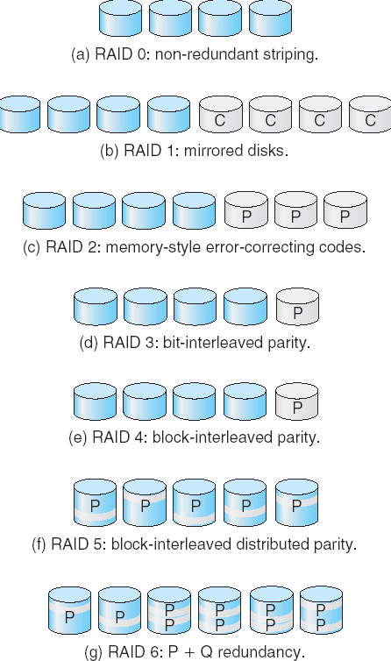
RAID
Mass-Storage Structure
These are the various levels of RAID.
The reliability increases with higher levels.
In practice, only levels 0, 1, 5 and 10 are typically used.
Several improvements in disk-use techniques involve the use of multiple disks working cooperatively.
Disk striping uses a group of disks as one storage unit.
RAID schemes improve performance and improve the reliability of the storage system by storing redundant data.
  Mirroring or shadowing keeps duplicate of each disk.
  Block interleaved parity uses much less redundancy.

Slide 11
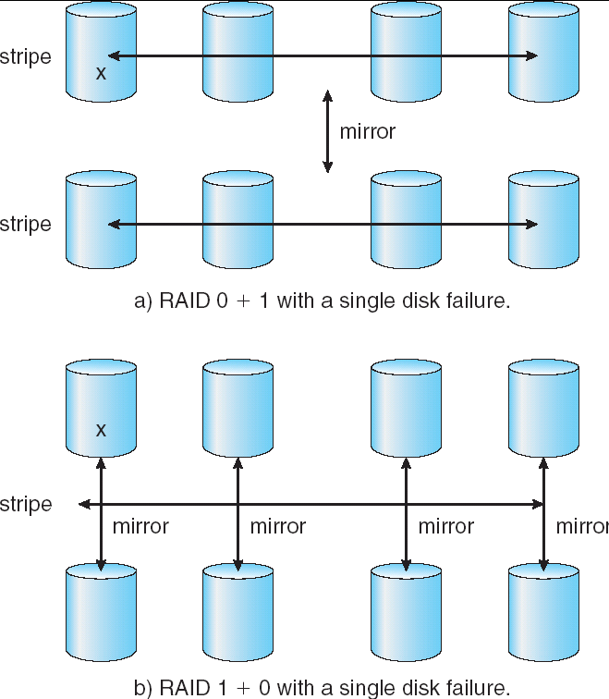
RAID
Mass-Storage Structure
RAID 10 becoming more and more popular.

Slide 12
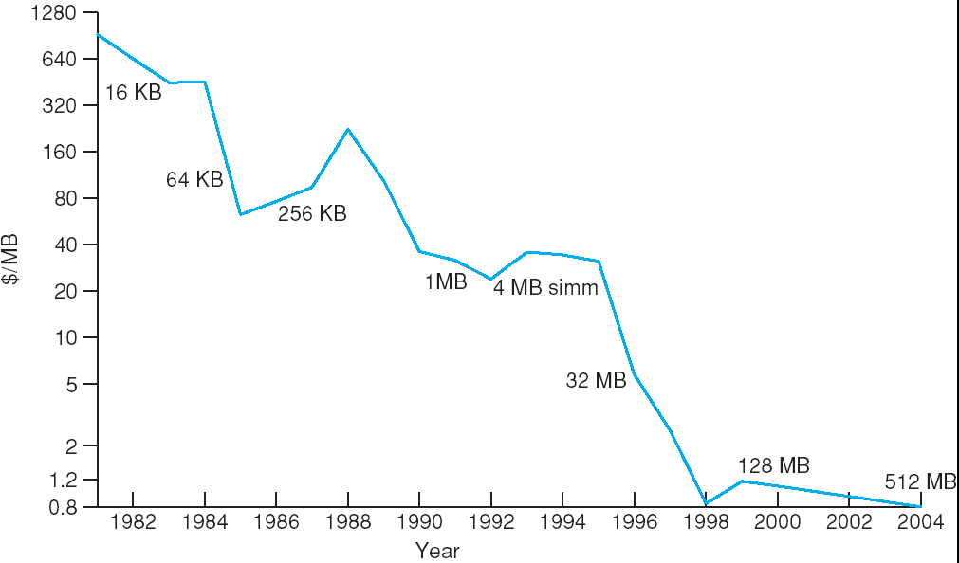
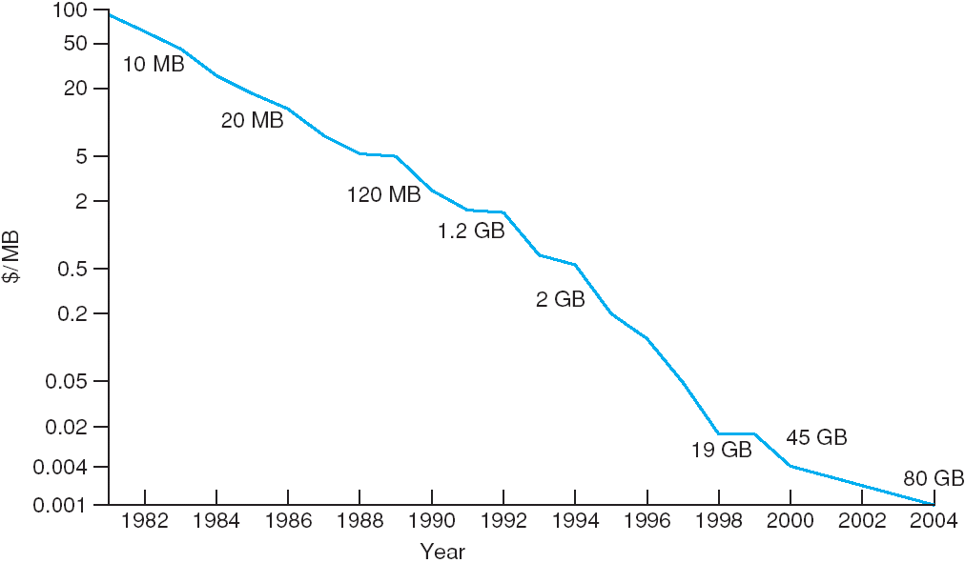
What Kind Of Storage Should You Use?
Mass-Storage Structure
Price per Megabyte of DRAM, From 1981 to 2004
Price per Megabyte of Hard Disk, From 1981 to 2004
Is it only about price?? Where does speed fit in?

Slide 13

IO Hardware
IO SYSTEMS
Incredible variety of I/O devices
Common concepts
  Port
  Bus (daisy chain or shared direct access)
  Controller (host adapter)
I/O instructions control devices
Devices have addresses, used by
  Direct I/O instructions
  Memory-mapped I/O

Slide 14
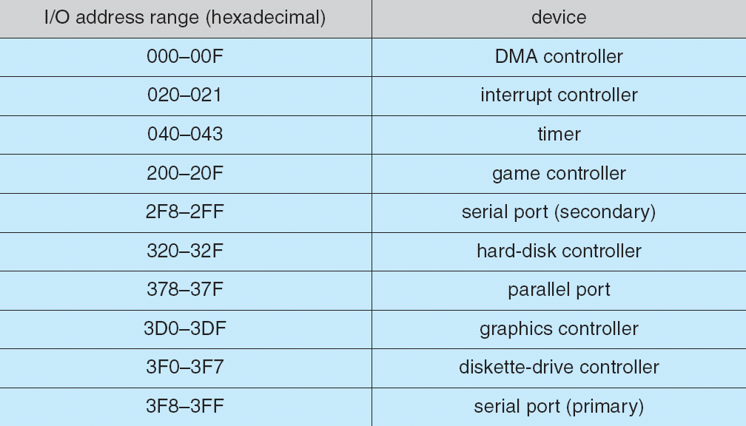
IO Hardware
IO SYSTEMS
Memory Mapped IO:
Works by associating a memory address with a device and a function on that device.

Slide 15
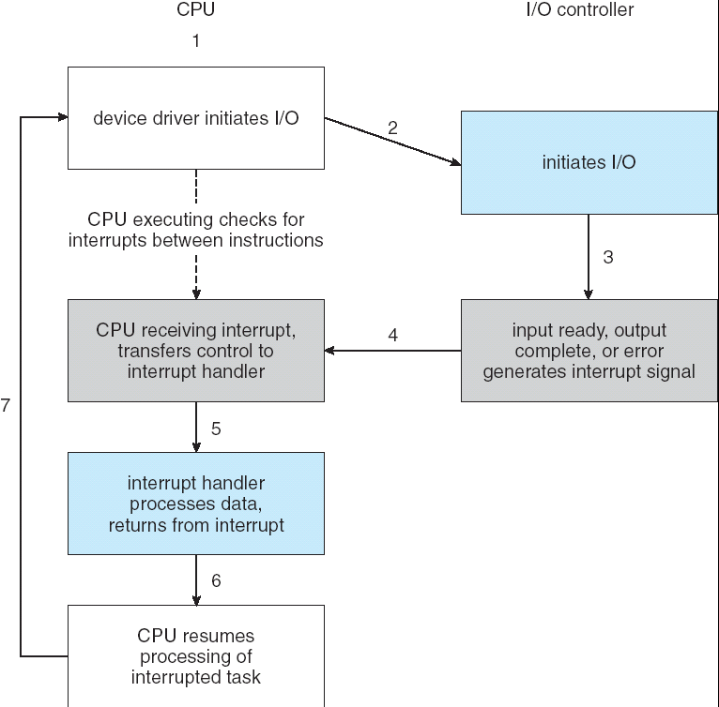
Polling and Interrupts
IO SYSTEMS
CPU Interrupt request line triggered by I/O device
Interrupt handler receives interrupts
Maskable to ignore or delay some interrupts
Interrupt vector to dispatch interrupt to correct handler
  Based on priority
  Some unmaskable
Interrupt mechanism also used for exceptions.

Slide 16
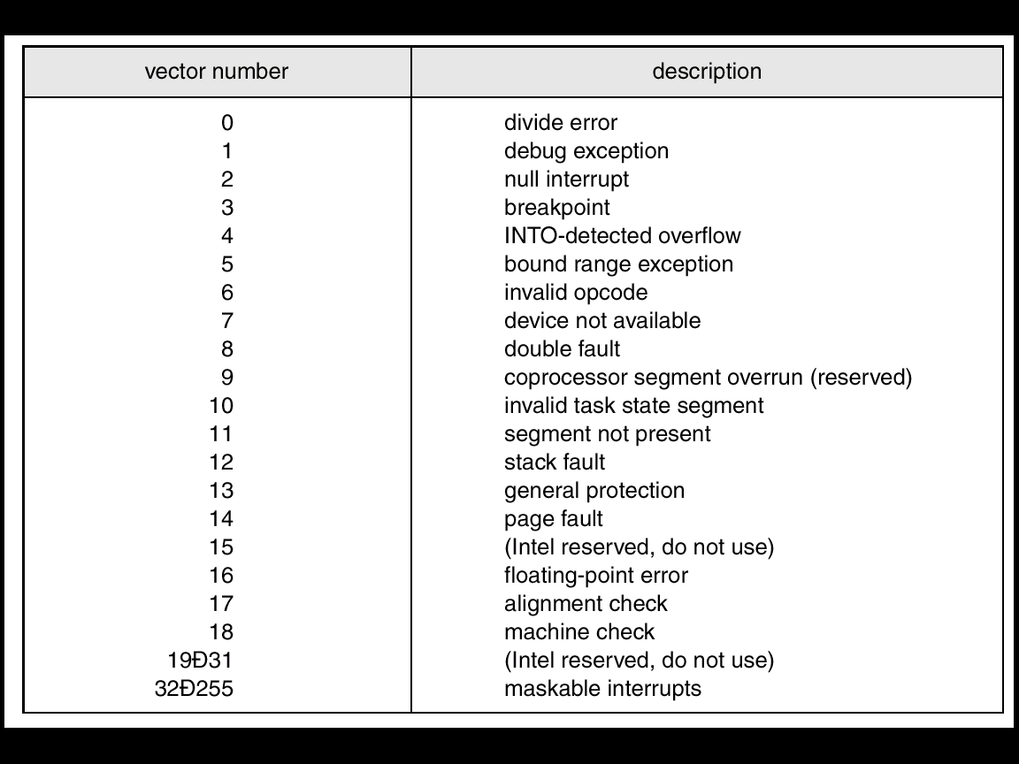
Polling and Interrupts
IO SYSTEMS
When you get an interrupt, you need to be able to figure out the device that gave you the interrupt.
These are the interrupt vectors for an Intel Processor.
Notice that most of these are actually exceptions.

Slide 17
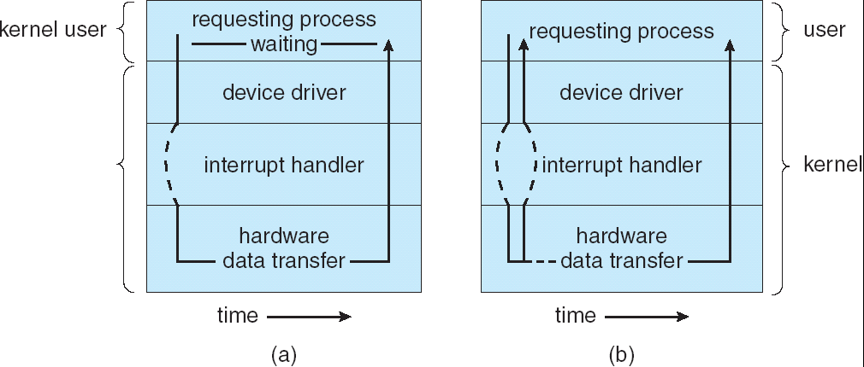
Synchronous or Asynchronous
IO SYSTEMS
Synchronous does the whole job – all at one time – data is obtained from the device by the processor.
Asynchronous has the device and the processor acting in time independent of each other.

Slide 18

DMA
IO SYSTEMS
Used to avoid programmed I/O for large data movement
Requires DMA controller
Bypasses CPU to transfer data directly between I/O device and memory

Slide 19
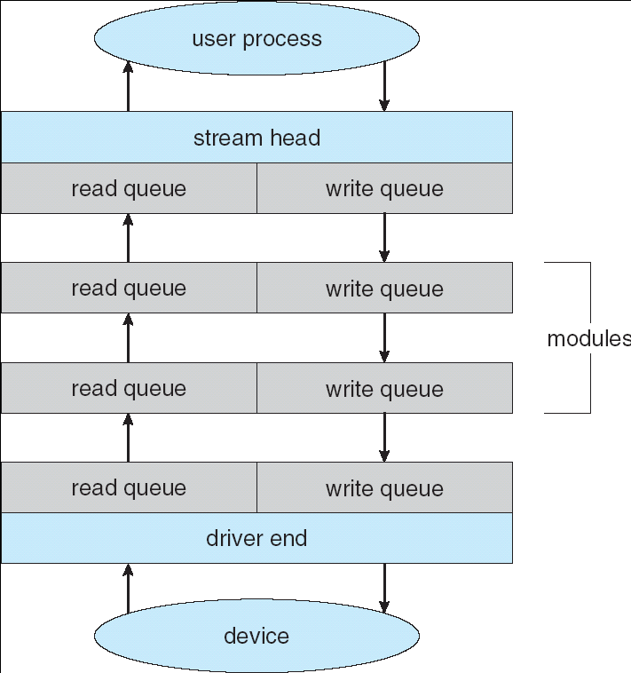
Streams
IO SYSTEMS
STREAM – a full-duplex communication channel between a user-level process and a device in Unix System V and beyond
A STREAM consists of:
- STREAM head interfaces
- driver end interfaces with the device
- zero or more STREAM modules between them.
Each module contains a read queue and a write queue
Message passing is used to communicate between queues

Slide 20
Interfaces
IO SYSTEMS
Block and Character Devices
Typical for disks – use read(), write(), seek() sequence.
Network Devices
Clocks and Timers
The OS uses an incredible number of clock calls – many events are timestamped within the OS
Blocking and Non-Blocking IO
Non- Blocking: Some devices are started by the OS, and then proceed on without further OS intervention. The delay timer in our project works this way.
Blocking: Any Read-Device will be blocking since the program can’t proceed until it gets the information it wanted from the device.

Slide 21
Kernel IO Subsystem
IO SYSTEMS
Buffering
Used to interface between devices of different speeds (modem and disk for instance.)
Interface between operations having different data sizes. (small network packets as part of a bigger transfer.)
Users often read or write small number of bytes – but the disk wants 4096 bytes. The filesystem maintains this buffer.
Spooling
Kernel data structures – what needs to be maintained to
Support the device
Support an instance of opening the device.

Slide 22
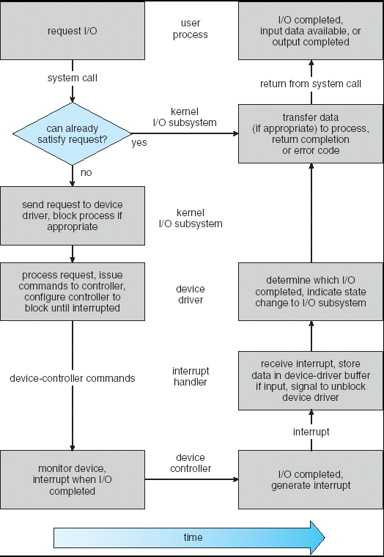
Kernel IO Subsystem
IO SYSTEMS
The steps in an IO request.

Slide 23
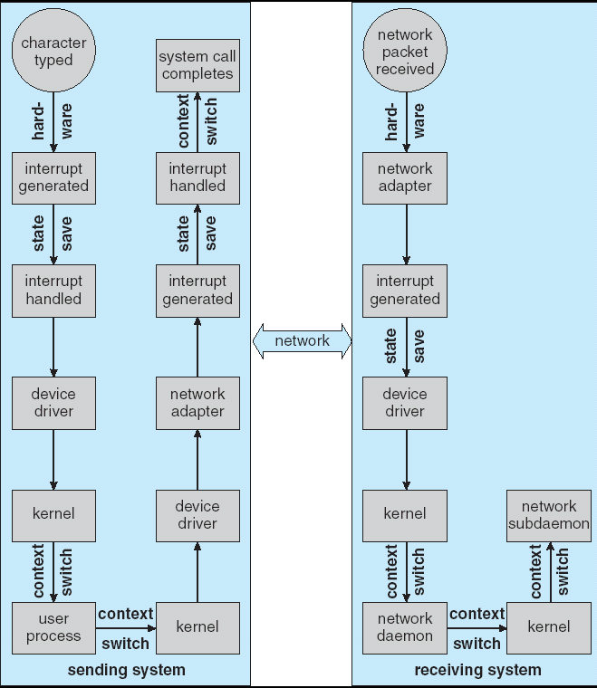
Performance
IO SYSTEMS
The steps required to handle a single keystroke across the network.

Slide 24
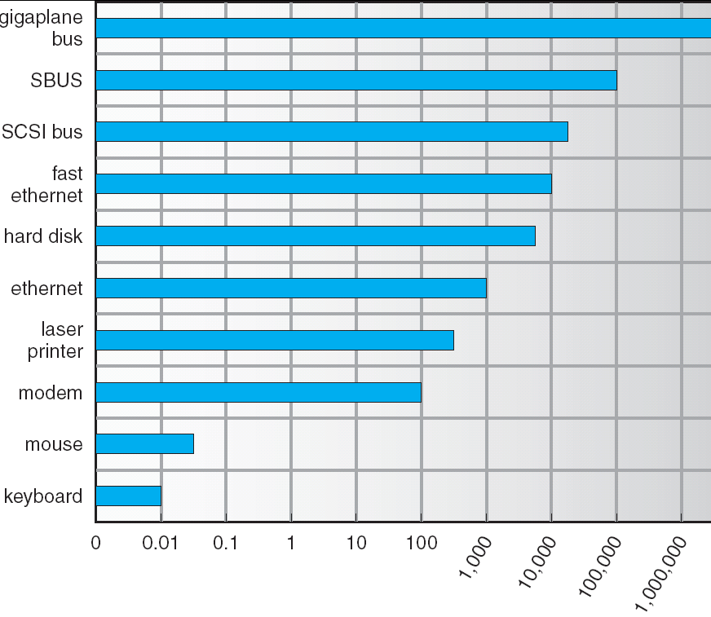
Performance
IO SYSTEMS
Throughput for various devices.
Figure 13.12

Slide 25
FILE SYSTEMS
Wrap Up
Mass Storage
This is about Disk Behavior and Management.
Disk Characteristics
Space Management
RAID
Disk Attachment
IO Interface
The busses in the computer and how the O.S. interfaces to it.
Talking to the IO – Polling, Interrupts and DMA
Application IO Interface
Kernel IO Subsystem

